Slide 1
Super Store Sales Analysis
By Power BI

Slide 2
Objective
To contribute to the success of a business by utilizing data analysis technique's specifically focusing on the series analysis to provide valuable insights and accurate sale forecasting

Slide 3
Description
The objective can be broken down into the following detailed
1.Dashboard Creation: Identify the KPIs, design an intuitive and visually appealing dashboard, add interactive visualizations and filtering capabilities to allow users to explore the data at various levels of granularity
2.Data Analysis: Provide valuable insights to business entities regarding the effectiveness of their sales strategies through visualization and charts.
3.Sales Forecasting: Leverage historic data and apply time series to generate sales forecasts for next 15 days
4.Actionable Insights and Recommendations: End goal is to insights and actionable information that can drive strategic decision making and support the supermarket's goals for growth, efficiency, satisfaction

Slide 4
Insights
Major insights
The majority of sales by payment mode is Cash on Delivery, accounting for 43%.
The West side region has the highest sales, contributing 33% of the total.
Sales are highest in the Consumer segment.
The maximum amount of sales is from Mobile devices.
California leads in sales among all states.
Sales are higher in December and September, while profits peak in December, October, and mid-March.

Slide 5
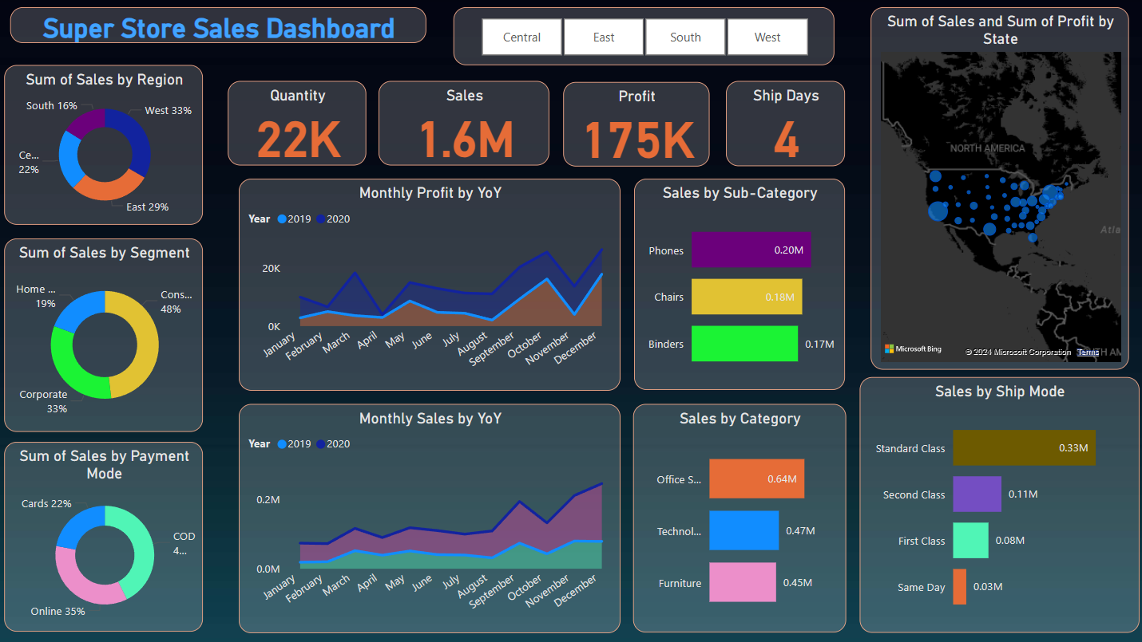

Slide 6
